Slide 1
B.N.M. Institute of Technology
Banashankari II Stage, Bangalore – 560 070
Seminar On Project Entitled “Optimization Techniques For Short-term Hydro Scheduling”
Project At:
Internal Guide: Sri. K. Venkatesha
Asst. Professor
EEE Department,BNMIT
By:
Ms. P.G. Apoorva-1BG07EE031
Mr. Subhashis Panda-1BG07EE050
Mr. Vivek Ranjan-1BG07EE057
External Guide: Atla Chandrasekhar Reddy
Sr. Engineer-Power System Studies
M/S PRDC Pvt. Ltd.

Slide 2
INTRODUCTION:
The aim is to schedule hydrogeneration for a period of 1day to 1 week for better reliable and economic operation of power system.
Types Of Hydroscheduling:
Long Term Scheduling(1week-3years)
Short Term Scheduling(1day-1week)
The objective of the short-term hydro scheduling program is to maximize the value of the stored energy in the reservoirs at the end of the study, which is equivalent to minimizing the value of the water flows through turbines and spillways.
Short-range hydro-scheduling (1 day to I wk) involves the hour-by-hour scheduling of all generation on a system to achieve minimum production cost for the given time period.

Slide 3
Real Time Input Obtained From Power System
Power System Problem Formulation Tool
Optimization Tool
Optimized Output

Slide 4
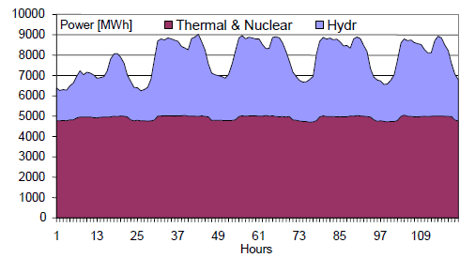
Various Aspects Of Scheduling:
Hydro+Thermal=Demand.
Scheduling Plays an vital role in power system reliabilty.
Cost Of Thermal production is v.high compared to Hydro.
Fig. 1 – Total hourly hydro and thermal power production
Notes:
Point2:Power companies in USA and other developed countries have to pay the customer for interrupted power supply.so the reliability for those countries is v.v.high (approx 99.999%). Where as in India it is in the range of 80-90%.So various optimization aspects are neglected and v.less research and development is happening in this field.

Slide 5
Water Inflow
Long Term Hydroscheduling
Hydro Scheduling
Short Term Hydrothermal
Co-ordination
Thermal Unit Commitment
OPF(Optimal Power Flow)

Slide 6
PROBLEM FORMULATION:
Objective function
Cost Function
Fuel Availability
Power System Model
Thermal
Constraints
Water Balance Equation
Storage & Discharge limitations
Power Production
Spill Characteristics
System Constraints
Hydro

Slide 7
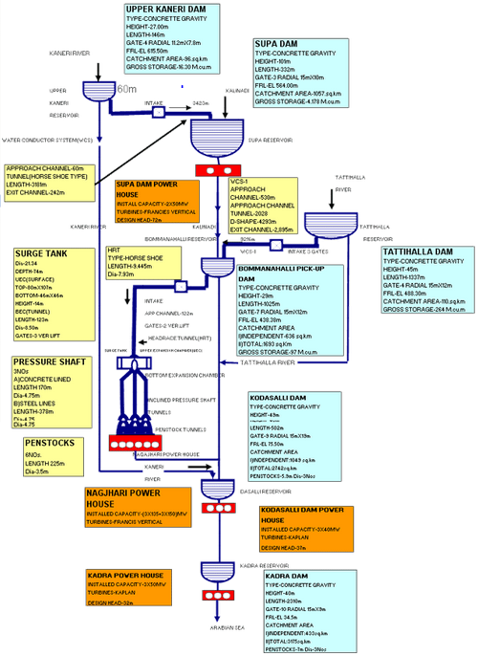
KALINADI HYDRO ELECTRIC PROJECT- FLOW CHART

Slide 8
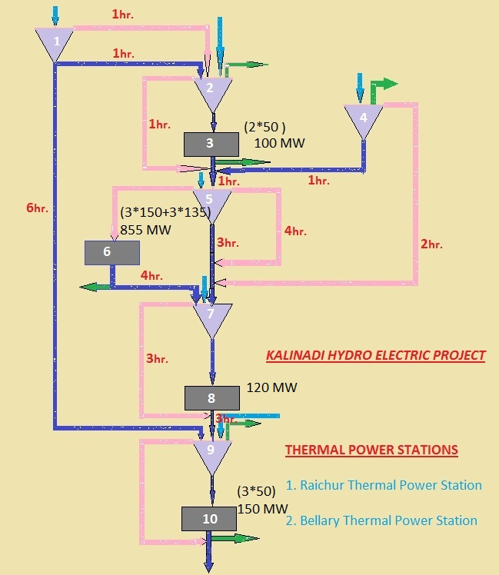

Slide 9
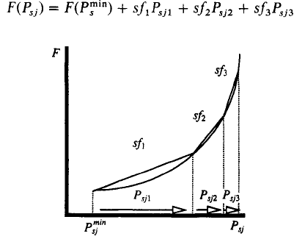
Objective Function:
Thermal Cost Function:-
Psj = The steam plant net output at time period j.
Sfk = The slopes of the piecewise linear steam-plant cost function.
FIG. 2 Steam plant piecewise linear cost function
Considering Two Thermal Units, The Objective function is:
Minimize,F=∑ ∑ fij+ds1+Srs1
Where: ds1 & Srs1 are the slack variables for demand and spinning reserve.
i=No. of units.
j=No of periods.

Slide 10
Hydro Constraints:
1)Water Balance Equation:
Water inflow(A)
Discharge(Q)
Spillage(S)
Volume Of Water In The Resorvoir(V)
Irrigation(I)
Time Delay(Important Consideration)
For Example, Let’s consider Resorvoir 7,
At the end Of 1st hour:
V71+S71+Q71=V70 +A71-I71
At the end Of 5th hour:
V75-V74-S52-S43-Q61-Q52+S75+Q75=A75-I75
Explains Time Delay

Slide 11
2)Storage & Discharge Limitations:
Initial Volume
Final Volume
Discharge Amount
Considering Resorvoir 2 i.e.(SUPA DAM):
V21 to V223=(55-4190 Million Cubic meter)
V20 & V224=(2178 Million Cubic meter)
Q2=Q3,Q7=Q8,Q9=Q10
Considering Plant3 i.e.(SUPA),the Discharge Limit is:
Q3=(0-154) For All T.
Similarly For plant 10 i.e.(Kadra),the Discharge Limit is:
Q10=(0-527) For All T.

Slide 12
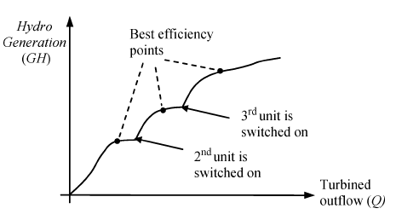
3)Hydro Power Production:
Fig. 3.Typical I/O function for a hydro plant with three units.
The Characteristics Shows:
P=KQ ;Where ,P=Hydro Generation,
K=slope
Q=Discharge
Considering 3rd Hydro Plant, We can write :
P31=K111*Q311+K112*Q312
Hence It is written for 2 slope characteristics.
Variable Head study can be implemented in future.

Slide 13
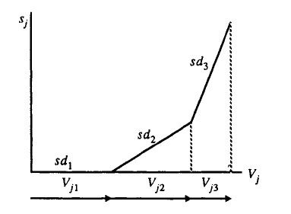
4)Spill Characteristics:
Controlled Spillage
Uncontrolled Spillage
FIG. 4 Spill characteristic.
The General Equation For Spillage is:
Considering Resorvoir 5,The Equation can be written as:
S51=V511*0+V512*.12+V513*.2
i.e 10-20% of the volume is considered for spilling action.

Slide 14
5)System Constraints:
1)Generation-Demand Balance Equation.
Hydro + Thermal=Demand
2)Spinning Reserve
To meet unexpected demand or forecast.
To meet unexpected generation failure.
The Equation For 1st Hour is:
P31+P61+P81+P101+G11+G21+ds1=4896(7815*.626488)
Where ,
ds1 is a slack variable which takes care of the spinning reserve.
G Is the Thermal Generation.
No. Of Hours | Karnataka Load Demand(P.U. Value) | Base Value
1 | .626488 | 7815 MW *Courstey KPCL
2 | .606398
3 | .575816
4 | .543954
5 | .551817
6 | .653103

Slide 15
Thermal Constraints:
Thermal Cost Function
Fuel Availability Constraint:
For RTPS:1Mw-hr of generation Requires 1.6 tonnes of Fuel.
For BTPS:1Mw-hr of generation Requires .64 tonnes of Fuel.
Considering Fuel availability as 8000 & 6000 tonnes/day for RTPS and BTPS respectively, The Equations are:
1.6g11+1.6g12+…………..+1.6g124<=8000 (RTPS)
.64g21+.64g22+…………...+.64g224<=6000 (BTPS)

Slide 16
Why LP?
Linear programming is one of the most famous optimization techniques for linear objectives and linear constraints.
Lagrange’s Method:
1)Difficult to add New Constraints
2)Less Flexible
3)More Complex
Dynamic Programming.
1)Time consuming
2)Becomes complex with increased no. of Variables.
Nonlinear Programming.
1)Research & Development On Progress.
2)Can be Implemented in Future.
Linear Programming:
1)Any constraint can be taken care Easily
2)Easier To solve
3)Requires Less time

Slide 17
Implemented Algorithms:
Revised Simplex Method
Can’t Handle Unbounded Cases.
Requires More Time Compared to IP Method.
Upper Bouding Method (Special Case Of Simplex Method)
Can Handle Problems With Limits Of Variables.
Interior Point methods:
Karmarkar’s Method
Requires Initial Feasible Solution
(An algorithm is implemented with limitations)
Can’t Handle All the LPs.
Dual Affine Variant Method
Requires Initial Feasible Solution
Can’t Handle All the LPs.

Slide 18
Applications:
Linear Programming Can be used for the optimization of:
Short & Long Term Hydro-Scheduling.
Economic Load Dispatch.
Unit Commitment.
Reactive Power Management.
Energy Management System.
Optimal Power Flow.
Apart from Power System Applications, they are used for the Optimization Studies of:
Production Management.
Aircraft Schedules.
Manufacturing Companies.
Resources Management.
And All Other Aspects.

Slide 19
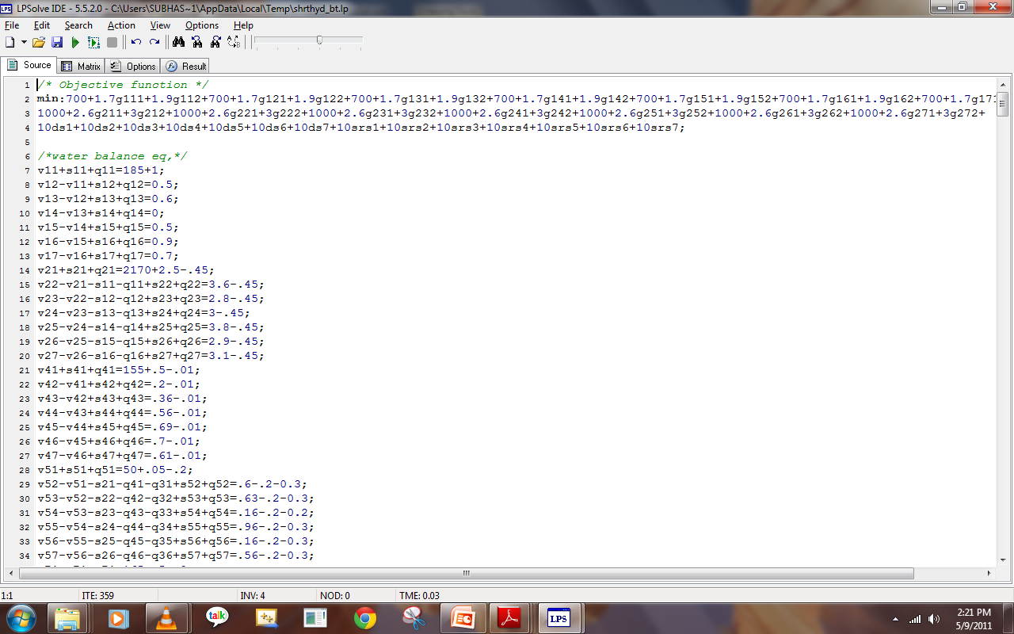
Result Analysis:
Input:

Slide 21
References:

